Slide 1
SC1004 Part 2
Lectured by Prof Guan Cuntai
(teaching materials by Prof Chng Eng Siong)
Email: ctguan@ntu.edu.sg

Slide 2
Quiz 2 and Exam:
Quiz 2
- Coverage : Ch 6 ,7, 8 - Time/Date: Week 13, last lecture time (10:30-11.20am, 17th April 2024)
2. Final Exam
- Coverage : Ch 6, 7, 8 (Q3 & Q4)
- Date/Time: 2 May 2024 (Thursday), 1.00-3.00pm
(Ch 9 will not be tested)

Slide 3
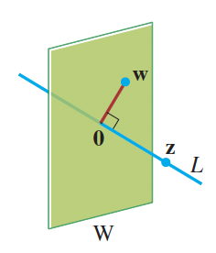
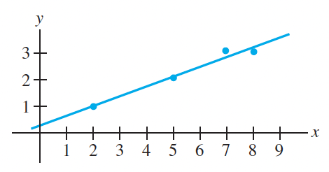
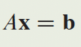
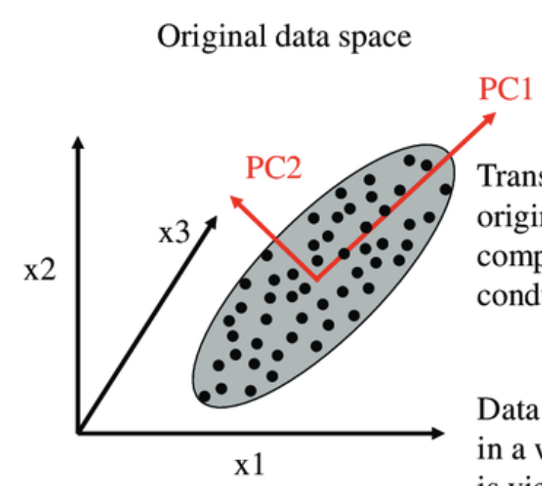
Syllabus for Part 2
Chapter | Topics | Week (Lecture) | Week (Tut)
6 | Orthogonality | 8-9 | 9-10
7 | Least Squares | 9-10 | 10-11
8 | EigenValue and Eigenvectors | 11-12 | 12-13
9 | Singular Value Decomposition (SVD) | 13
Table 1: schedule

Slide 4
Online Video learning Schedule
https://www.youtube.com/channel/UCBzG5jg3huxiPkCt-Serrjw
Week | Part | Topic | Notes
8 | 6.1.1-6.2.3 | Orthogonality, Normalization, Dot-Product, Inequalities, | Lecture 1: 6.1.1 - 6.1.3 Lecture 2: 6.1.4 - 6.2.3
9 | 6.2.4-6.3.2 | Orthogonal/Orthonormal Sets, Basis, Gram Schmidt and QR Decomposition | Lecture 3: 6.2.4 Lecture 4: 6.2.5 – 6.3.2
10 | 7.1.1-7.2.1 | Least Squares and Normal Eqn, Projection Matrix, Applications | Lecture 5: 7.1.1 – 7.1.3 Lecture 6: 7.1.4 – 7.2.1
11 | 8.1.1-8.1.2 | Eigenvectors, Eigen-values, Characteristics Eqn | Lecture 7: 8.1.1 Lecture 8: 8.1.2
12 | 8.1.3-8.1.5 | Diagonalisation, Power of A, Change of basis | Lecture 9: 8.1.3 Lecture 10: 8.1.4 – 8.1.5
13 | 9.1.1-9.2 | Introduction to SVD and PCA (Not examined in quiz/exam) | Lecture 11: 9.1.1 – 9.2 Lecture 12: Quiz 2

Slide 5
How will we conduct the course?
Before the lectures, watch the videos according to the schedule in Table 1
You can watch past years zoom video recordings at
https://www.youtube.com/@linearalgebra1884/playlists?view=50&sort=dd&shelf_id=2
During lecture hours –
We will summarize the lectures and highlight the key points
Q&A.

Slide 6
References

Slide 7
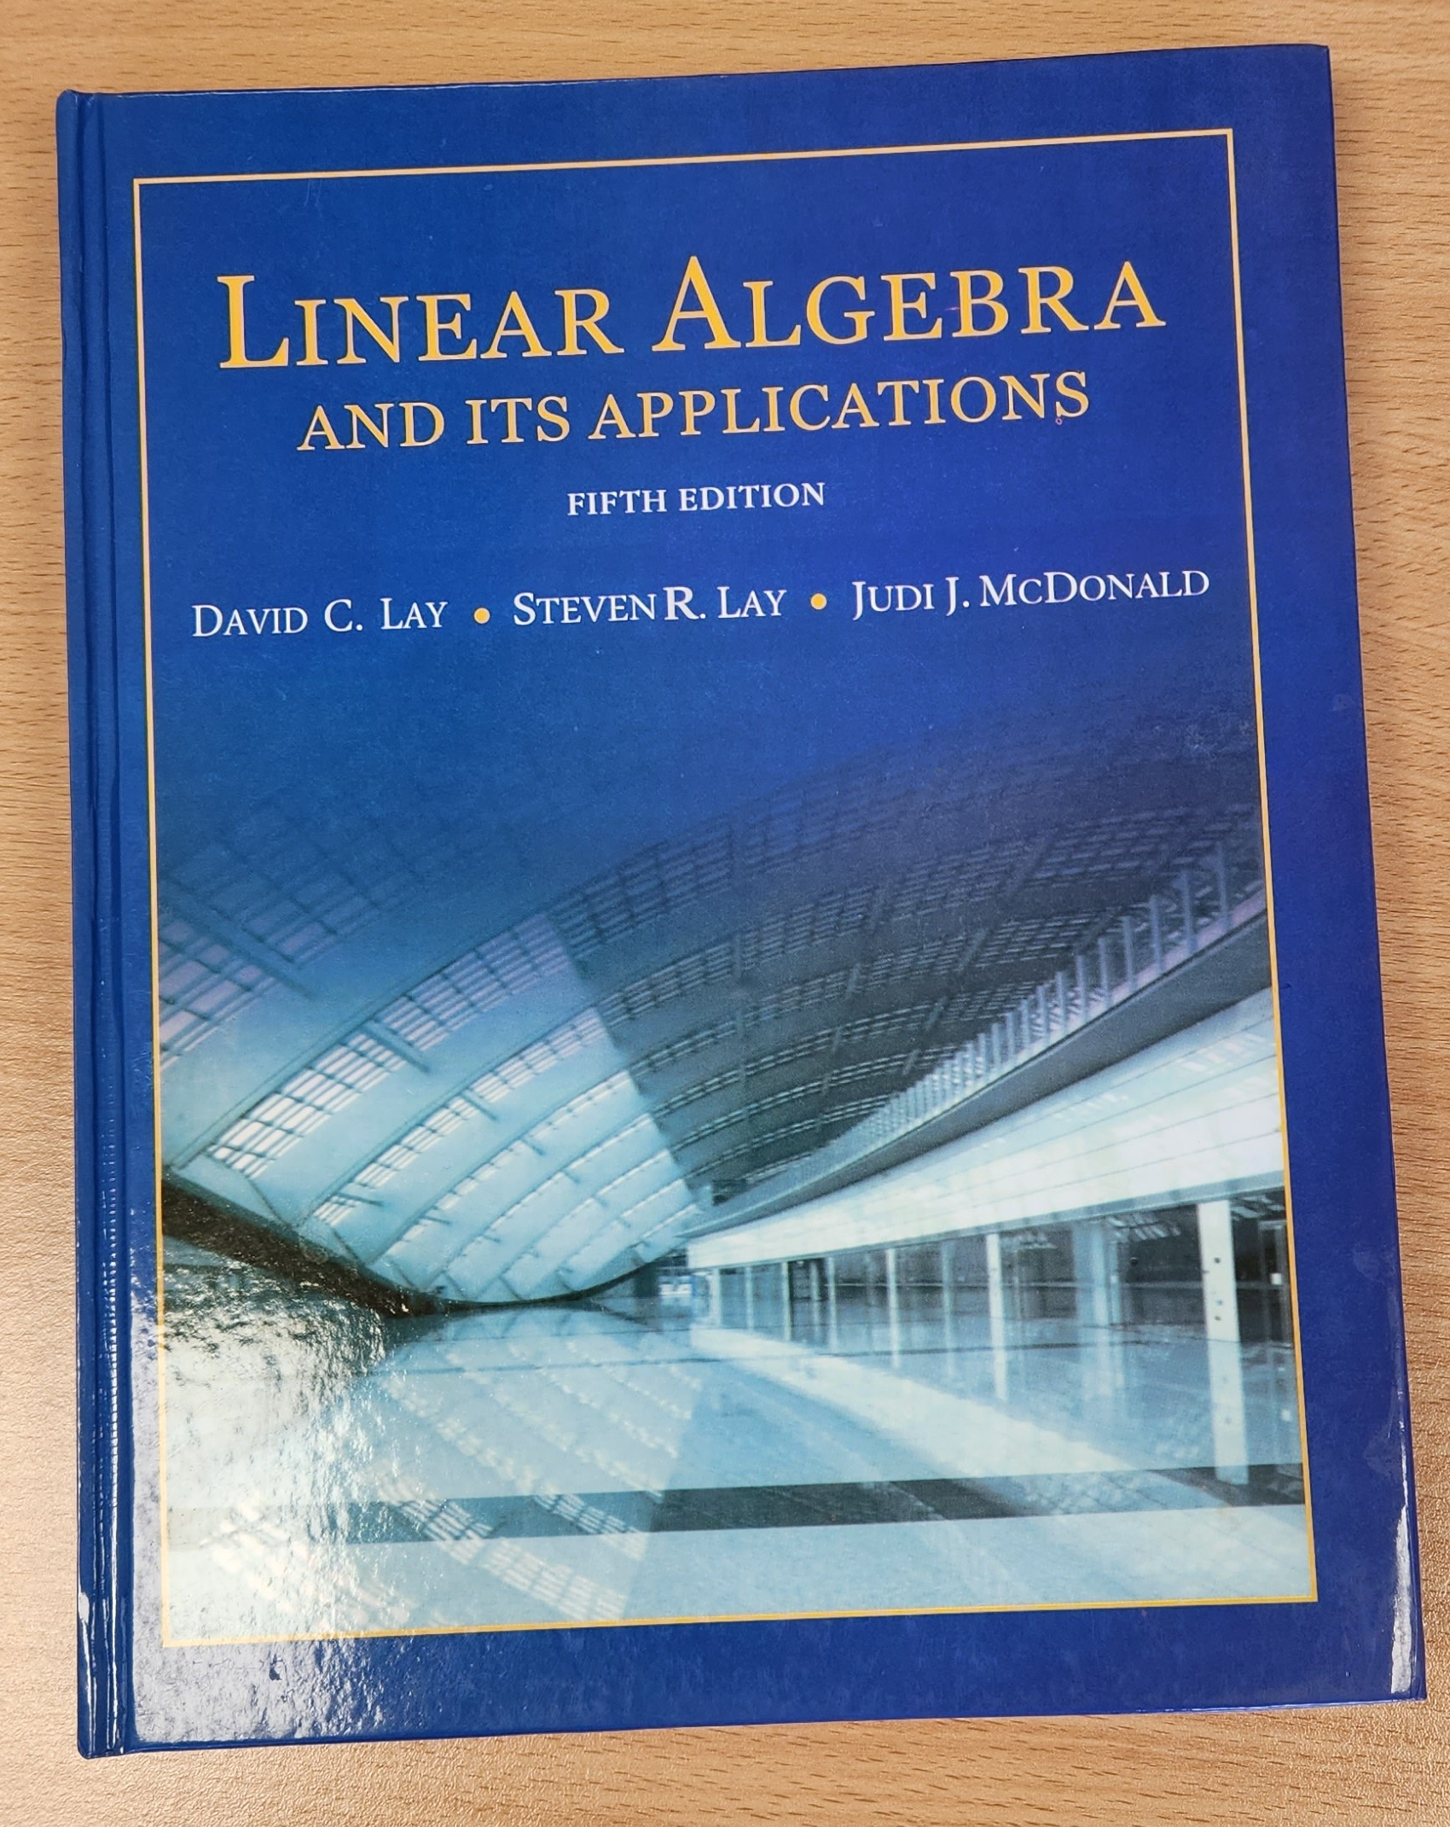

3Blue1Brown on YouTube
https://www.youtube.com/playlist?list=PLZHQObOWTQDPD3MizzM2xVFitgF8hE_ab
Linear Algebra and Its Applications
by David Lay, Steven Lay, Judi McDonald

Slide 8
Lecture (Week 12) (Chapter 8.1.3-8.1.5)

Slide 9
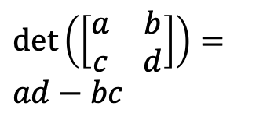
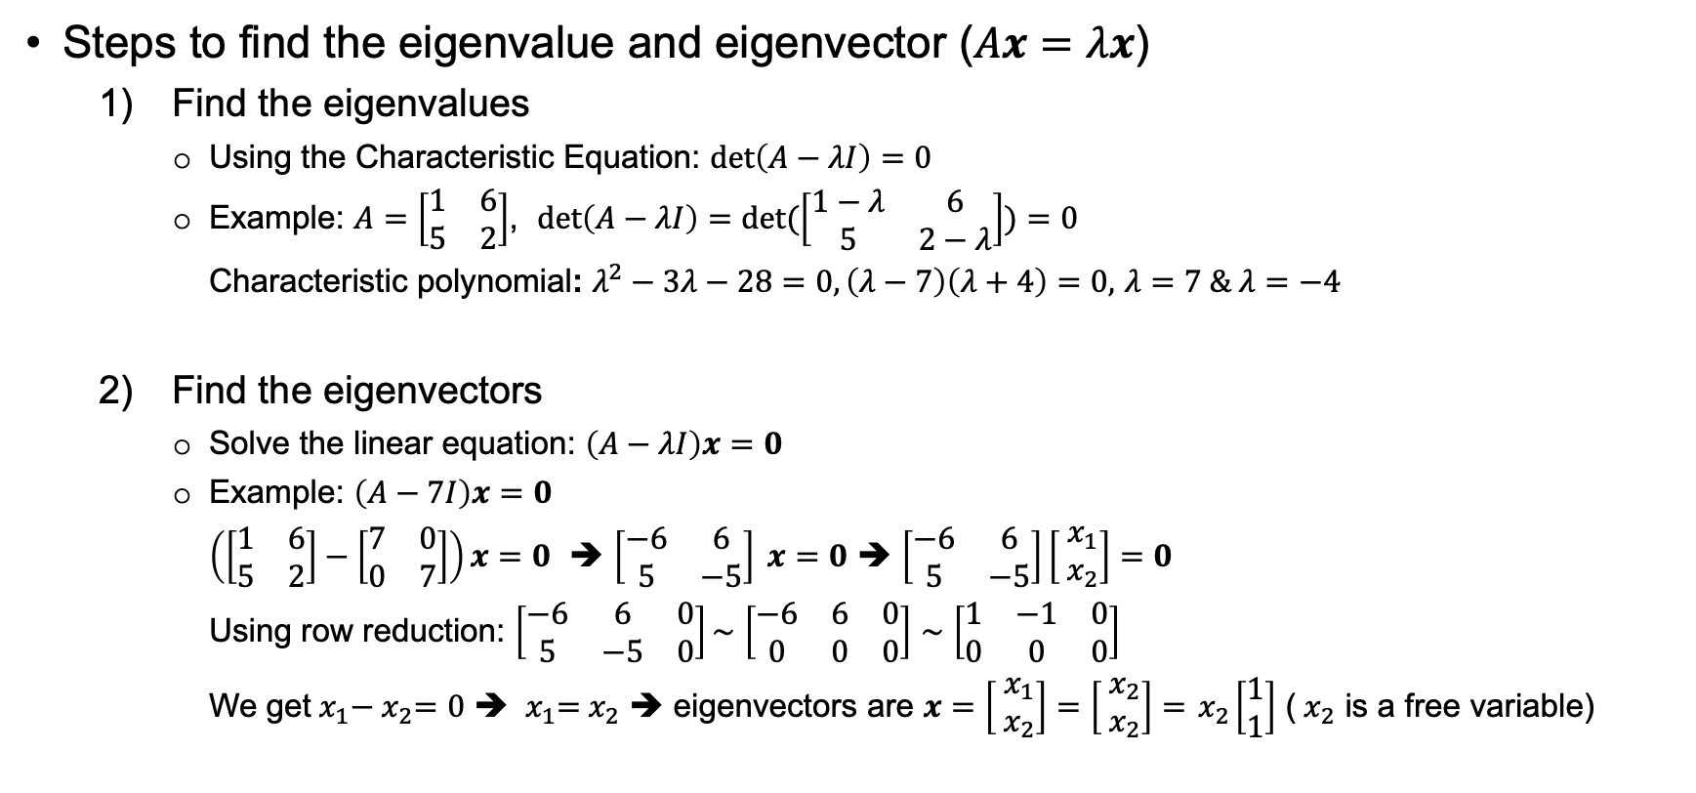
Key points – Eigenvalue and Eigenvector
Revision
Steps to find the eigenvalue and eigenvector ($Ax=λx$)
Find the eigenvalues
Using the Characteristic Equation: $det\left(A−λI\right)=0$
Example: $A=\left[\begin{matrix}1 & 6 \\ 5 & 2\end{matrix}\right]$, $det\left(A−λI\right)=det(\left[\begin{matrix}1−λ & 6 \\ 5 & 2−λ\end{matrix}\right])=0$
Characteristic polynomial: $λ^{2}−3λ−28=0, \left(λ−7\right)\left(λ+4\right)=0,$ $λ=7 \& λ=−4$
Find the eigenvectors
Solve the linear equation: $\left(A−λI\right)x=0$
Example: $\left(A−7I\right)x=0$
$\left(\left[\begin{matrix}1 & 6 \\ 5 & 2\end{matrix}\right]−\left[\begin{matrix}7 & 0 \\ 0 & 7\end{matrix}\right]\right)x=0$ ➔ $\left[\begin{matrix}−6 & 6 \\ 5 & −5\end{matrix}\right] x=0$ ➔ $\left[\begin{matrix}−6 & 6 \\ 5 & −5\end{matrix}\right]\left[\begin{matrix}{ x}_{1} \\ { x}_{2}\end{matrix}\right]=0$
Using row reduction: $\left[\begin{matrix}−6 & 6 & 0 \\ 5 & −5 & 0\end{matrix}\right]\sim$ $\left[\begin{matrix}−6 & 6 & 0 \\ 0 & 0 & 0\end{matrix}\right]$ $\sim$ $\left[\begin{matrix}1 & −1 & 0 \\ 0 & 0 & 0\end{matrix}\right]$
We get${ x}_{1}−{ x}_{2}=0$ ➔ ${ x}_{1}={ x}_{2}$ ➔ eigenvectors are $x=\left[\begin{matrix}{ x}_{1} \\ { x}_{2}\end{matrix}\right]=$ $\left[\begin{matrix}{ x}_{2} \\ { x}_{2}\end{matrix}\right]={ x}_{2}\left[\begin{matrix}1 \\ 1\end{matrix}\right]$ (${ x}_{2}$ is a free variable)
$det\left(\left[\begin{matrix}a & b \\ c & d\end{matrix}\right]\right)=ad−bc$

Slide 10
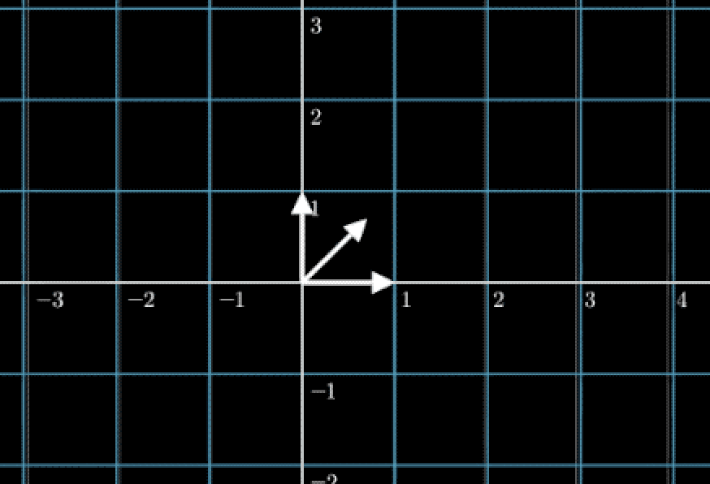
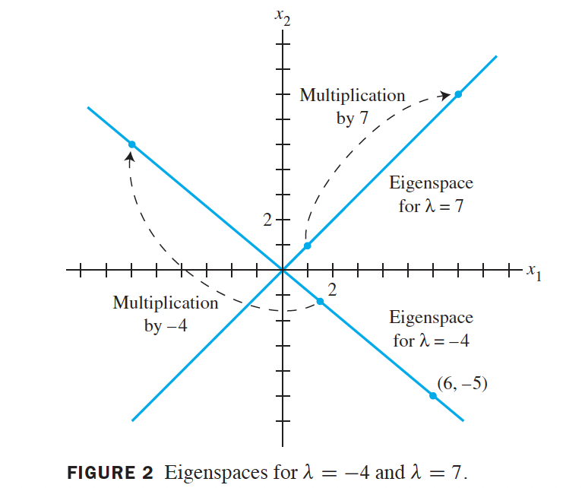
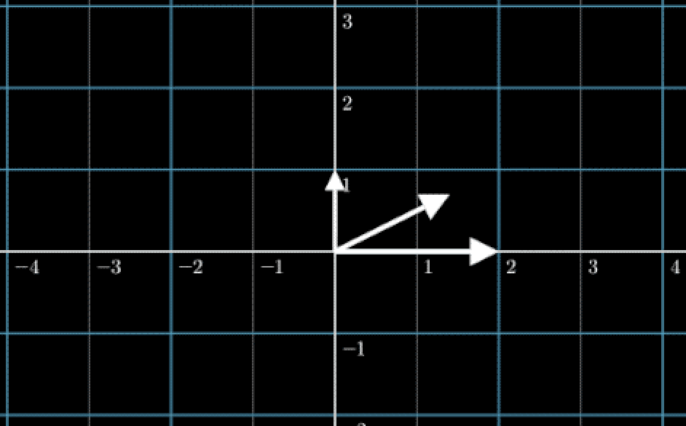
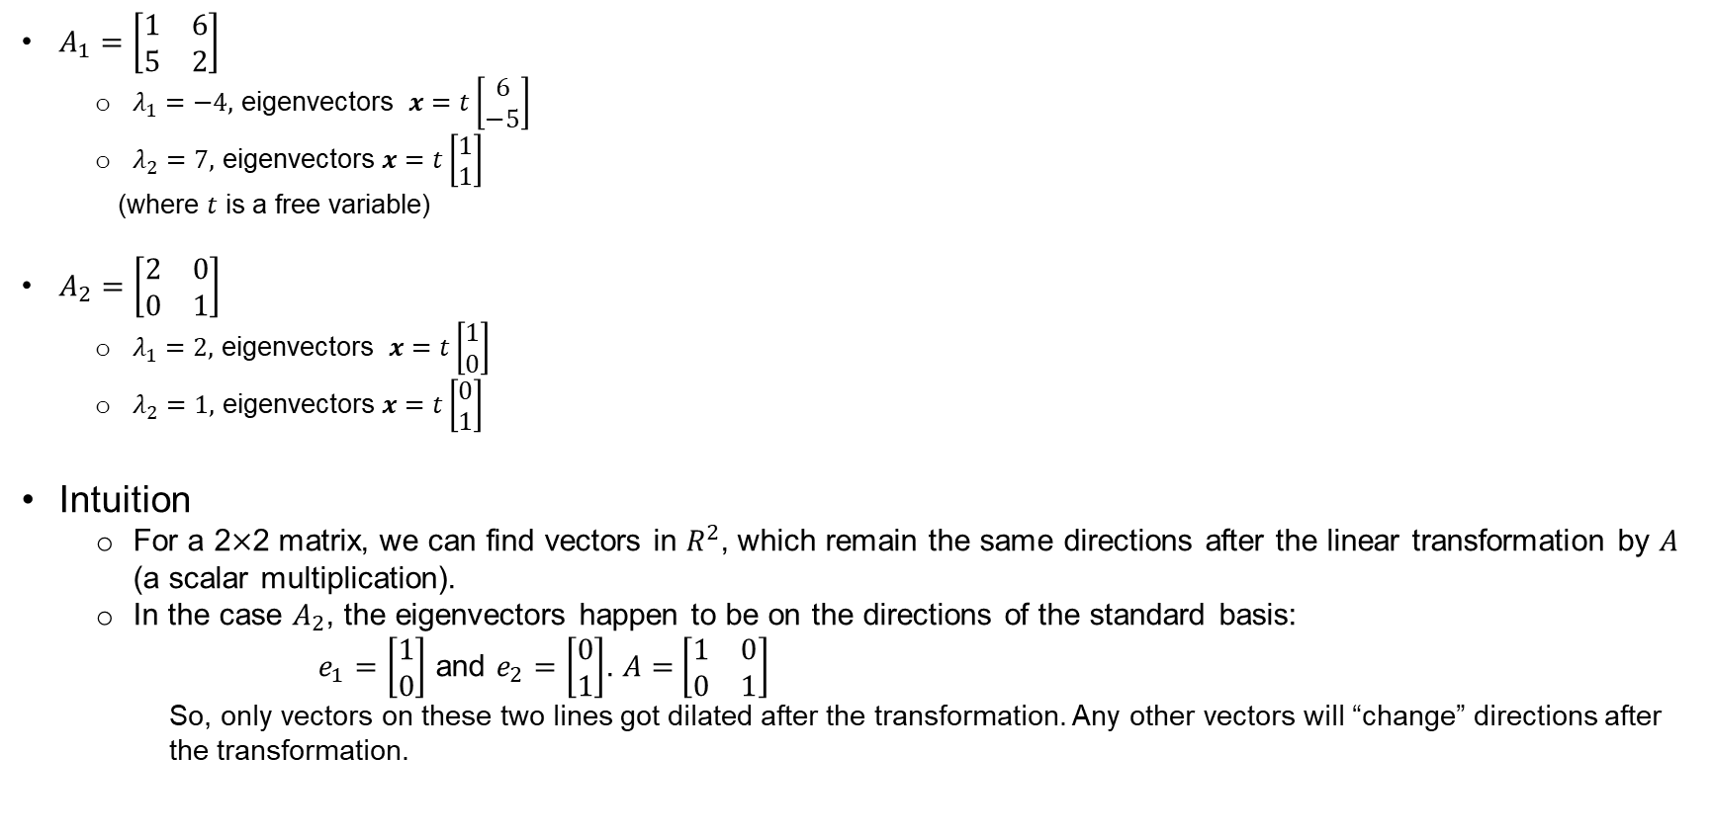

Key points – Eigenvector Intuition
Revision
$A_{1}=\left[\begin{matrix}1 & 6 \\ 5 & 2\end{matrix}\right]$
$λ_{1}=−4,$ eigenvectors $x=t\left[\begin{matrix}6 \\ −5\end{matrix}\right]$
$λ_{2}=7,$ eigenvectors $x=t\left[\begin{matrix}1 \\ 1\end{matrix}\right]$
(where $t$ is a free variable)
$A_{2}=\left[\begin{matrix}2 & 0 \\ 0 & 1\end{matrix}\right]$
$λ_{1}=2,$ eigenvectors $x=t\left[\begin{matrix}1 \\ 0\end{matrix}\right]$
$λ_{2}=1,$ eigenvectors $x=t\left[\begin{matrix}0 \\ 1\end{matrix}\right]$
Intuition
For a 2$×$2 matrix, we can find vectors in $R^{2}$, which remain the same directions after the linear transformation by $A$ (a scalar multiplication).
In the case $A_{2}$, the eigenvectors happen to be on the directions of the standard basis:
$e_{1}=\left[\begin{matrix}1 \\ 0\end{matrix}\right]$ and $e_{2}=\left[\begin{matrix}0 \\ 1\end{matrix}\right]$. $A=$ $\left[\begin{matrix}1 & 0 \\ 0 & 1\end{matrix}\right]$
So, only vectors on these two lines got dilated after the transformation. Any other vectors will “change” directions after the transformation.
Multiplied by $A$

Slide 11
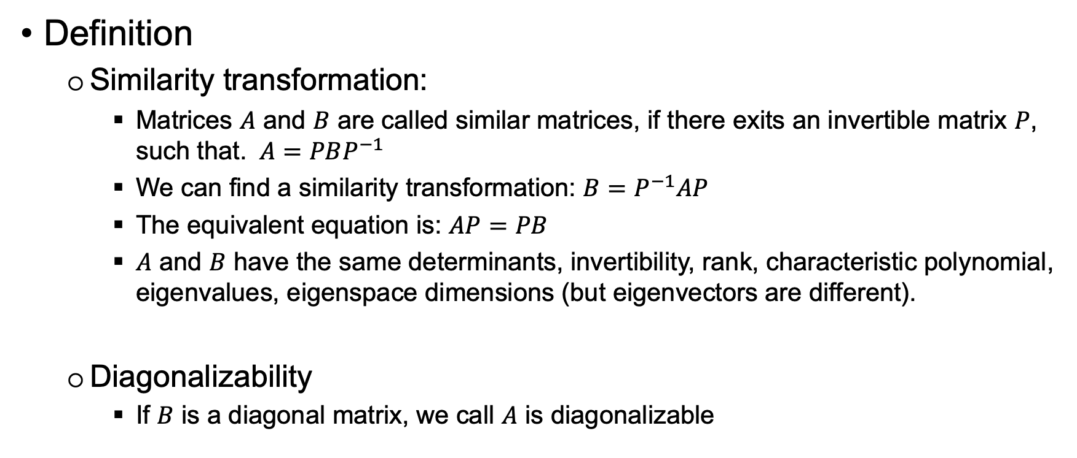

Key points – 8.1.3 Similarity and Diagonalizability
Definition
Similarity transformation:
Matrices $A$ and $B$ are called similar matrices, if there exits an invertible matrix $P$, such that. $A=PBP^{−1}$
We can find a similarity transformation: $B=P^{−1}AP$
The equivalent equation is: $AP=PB$
$A$ and $B$ have the same determinants, invertibility, rank, characteristic polynomial, eigenvalues, eigenspace dimensions (but eigenvectors are different).
Diagonalizability
If $B$ is a diagonal matrix, we call $A$ is diagonalizable
Notes:
The relationship $A=PBP^{−1}$ describes two matrices $A$ and $B$ that are similar, implying that while $A$ and $B$ may look different, they represent the same linear transformation under different bases. The matrix $P$ is the change-of-basis matrix that transitions from the basis in which $B$ is expressed to the basis in which $A$ is expressed.
Same Determinants
det($A$)=det($PBP^{−1}$)
det($PBP^{−1}$)=det($P$)det($B$)det($P^{−1}$)
Since det($P^{−1}$)=1/det($P$), we have:
det($A$)= det($PBP^{−1}$)= det($P$)det($B$)(1/det($P$)) = det($B$)
Invertibility
Since det($A$)= det($B$), if one of the matrices is invertible (nonzero determinant), the other must also be invertible.
Same Rank
The rank of a matrix is the dimension of the vector space spanned by its columns (or rows). For similar matrices, the transformations they represent, albeit in different bases, span spaces of the same dimension. Thus, they have the same rank.
Characteristic Polynomial, Eigenvalues, and Eigenspace Dimensions
The characteristic polynomial of a matrix $A$ is given by $det\left(A−λI\right)$.
For similar matrices, $PBP^{−1}−λI=PBP^{−1}−PλP^{−1}=P(B−λI{)P}^{−1}$
$det\left(A−λI\right)$= $det\left(P(B−λI\right)P^{−1})=det\left(P)det(B−λI\right){det(P}^{−1})=det\left(B−λI\right)$
they have the same characteristic polynomial, and consequently, the same eigenvalues.
The dimensions of the eigenspaces are determined by the eigenvalues and the algebraic multiplicity of these eigenvalues. Since $A$ and $B$ have the same eigenvalues with the same algebraic multiplicity, the dimensions of their eigenspaces (the geometric multiplicity) are the same.
Eigenvectors
While $A$ and $B$ have the same eigenvalues, their eigenvectors are not necessarily the same. This is because eigenvectors are directions that are invariant under the linear transformation represented by a matrix. Since $A$ and $B$ represent the same transformation under different bases, the "directions" in one base correspond to different "directions" in another. If $v$ is an eigenvector of $B$, then $Pv$is the corresponding eigenvector of $A$. Hence, the change-of-basis matrix $P$ transforms eigenvectors of $B$ into eigenvectors of $A$, explaining why the eigenvectors are different for similar matrices.

Slide 12
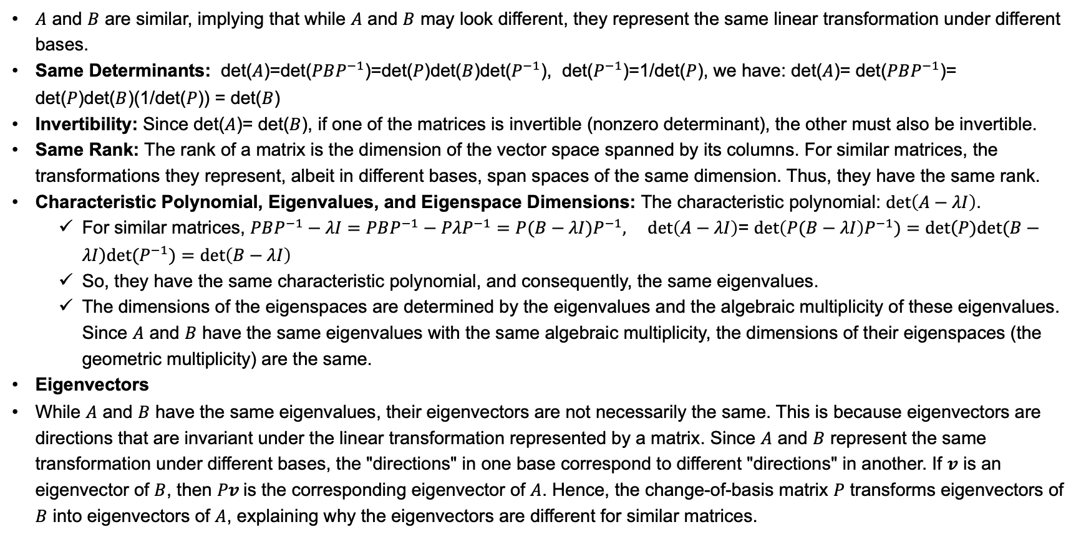

Explain: $A$ and $B$ have the same determinants, invertibility, rank, characteristic polynomial, eigenvalues, eigenspace dimensions (but eigenvectors are different)
$A$ and $B$ are similar, implying that while $A$ and $B$ may look different, they represent the same linear transformation under different bases.
Same Determinants: det($A$)=det($PBP^{−1}$)=det($P$)det($B$)det($P^{−1}$), det($P^{−1}$)=1/det($P$), we have: det($A$)= det($PBP^{−1}$)= det($P$)det($B$)(1/det($P$)) = det($B$)
Invertibility: Since det($A$)= det($B$), if one of the matrices is invertible (nonzero determinant), the other must also be invertible.
Same Rank: The rank of a matrix is the dimension of the vector space spanned by its columns. For similar matrices, the transformations they represent, albeit in different bases, span spaces of the same dimension. Thus, they have the same rank.
Characteristic Polynomial, Eigenvalues, and Eigenspace Dimensions: The characteristic polynomial: $det\left(A−λI\right)$.
For similar matrices, $PBP^{−1}−λI=PBP^{−1}−PλP^{−1}=P(B−λI{)P}^{−1}, det\left(A−λI\right)$= $det\left(P(B−λI\right)P^{−1})=det\left(P)det(B−λI\right){det(P}^{−1})=det\left(B−λI\right)$
So, they have the same characteristic polynomial, and consequently, the same eigenvalues.
The dimensions of the eigenspaces are determined by the eigenvalues and the algebraic multiplicity of these eigenvalues. Since $A$ and $B$ have the same eigenvalues with the same algebraic multiplicity, the dimensions of their eigenspaces (the geometric multiplicity) are the same.
Eigenvectors
While $A$ and $B$ have the same eigenvalues, their eigenvectors are not necessarily the same. This is because eigenvectors are directions that are invariant under the linear transformation represented by a matrix. Since $A$ and $B$ represent the same transformation under different bases, the "directions" in one base correspond to different "directions" in another. If $v$ is an eigenvector of $B$, then $Pv$is the corresponding eigenvector of $A$. Hence, the change-of-basis matrix $P$ transforms eigenvectors of $B$ into eigenvectors of $A$, explaining why the eigenvectors are different for similar matrices.

Slide 13
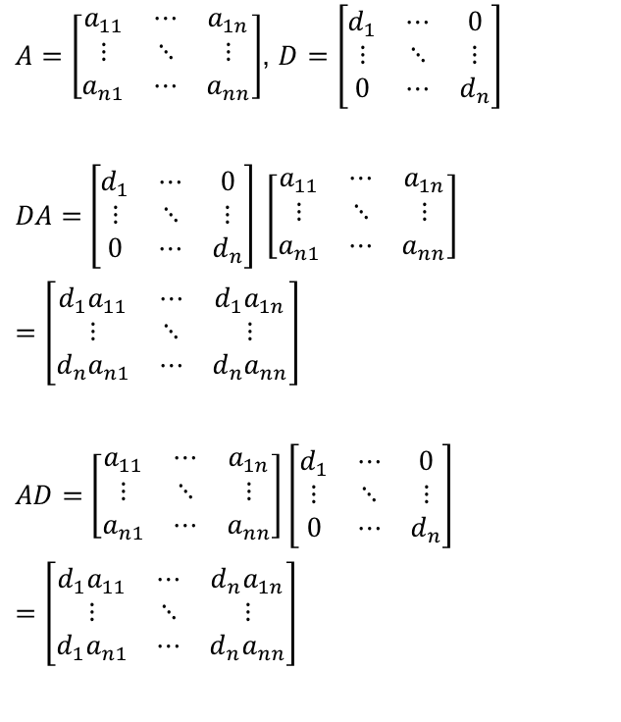
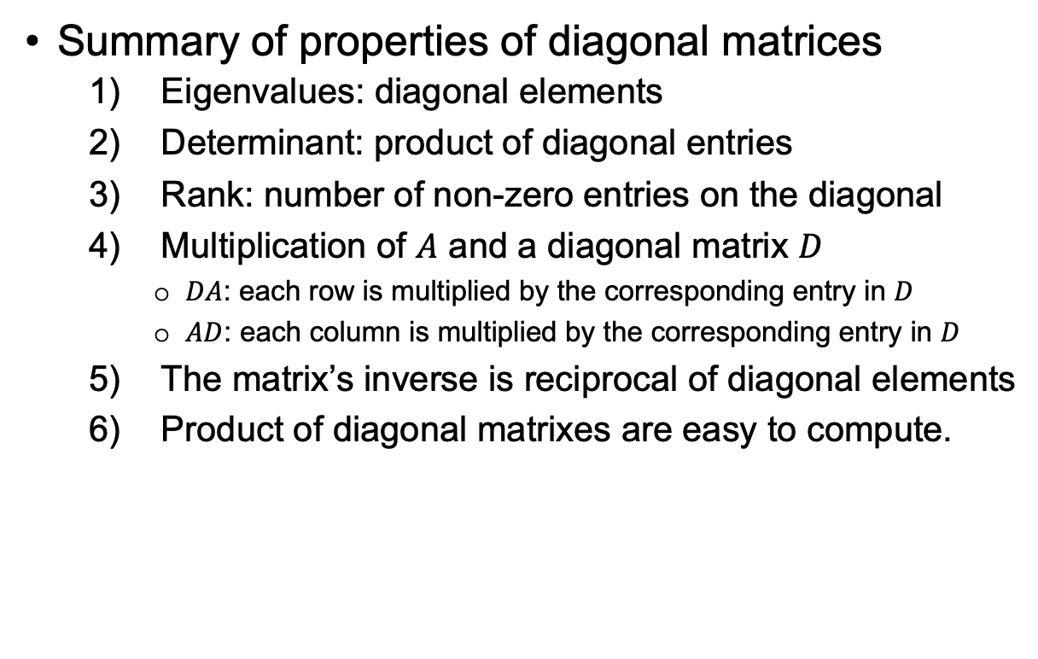
Key points – 8.1.3 Properties of Diagonal Matrices
Summary of properties of diagonal matrices
Eigenvalues: diagonal elements
Determinant: product of diagonal entries
Rank: number of non-zero entries on the diagonal
Multiplication of $A$ and a diagonal matrix $D$
$DA$: each row is multiplied by the corresponding entry in $D$
$AD$: each column is multiplied by the corresponding entry in $D$
The matrix’s inverse is reciprocal of diagonal elements
Product of diagonal matrixes are easy to compute.
$A=\left[\begin{matrix}a_{11} & ⋯ & a_{1n} \\ ⋮ & ⋱ & ⋮ \\ a_{n1} & ⋯ & a_{nn}\end{matrix}\right]$, $D=\left[\begin{matrix}d_{1} & ⋯ & 0 \\ ⋮ & ⋱ & ⋮ \\ 0 & ⋯ & d_{n}\end{matrix}\right]$
$DA=$ $\left[\begin{matrix}d_{1} & ⋯ & 0 \\ ⋮ & ⋱ & ⋮ \\ 0 & ⋯ & d_{n}\end{matrix}\right] \left[\begin{matrix}a_{11} & ⋯ & a_{1n} \\ ⋮ & ⋱ & ⋮ \\ a_{n1} & ⋯ & a_{nn}\end{matrix}\right]$
$$=\left[\begin{matrix}{d_{1}a}_{11} & ⋯ & {d_{1}a}_{1n} \\ ⋮ & ⋱ & ⋮ \\ d_{n}a_{n1} & ⋯ & {d_{n}a}_{nn}\end{matrix}\right]$$
$AD=$ $\left[\begin{matrix}a_{11} & ⋯ & a_{1n} \\ ⋮ & ⋱ & ⋮ \\ a_{n1} & ⋯ & a_{nn}\end{matrix}\right]$ $\left[\begin{matrix}d_{1} & ⋯ & 0 \\ ⋮ & ⋱ & ⋮ \\ 0 & ⋯ & d_{n}\end{matrix}\right]$
$$=\left[\begin{matrix}{d_{1}a}_{11} & ⋯ & {d_{n}a}_{1n} \\ ⋮ & ⋱ & ⋮ \\ d_{1}a_{n1} & ⋯ & {d_{n}a}_{nn}\end{matrix}\right]$$

Slide 14
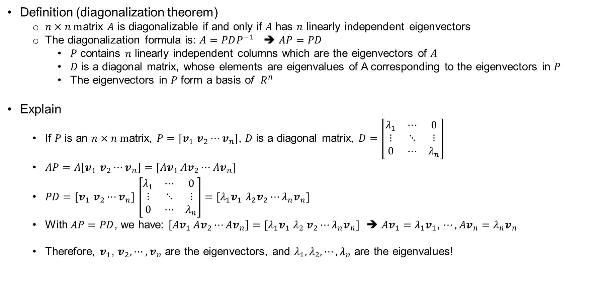

Key points – 8.1.3 Diagonalize a Matrix
Definition (diagonalization theorem)
$n×n m$atrix $A$ is diagonalizable if and only if $A$ has $n$ linearly independent eigenvectors
The diagonalization formula is: $A=PDP^{−1}$ ➔ $AP=PD$
$P$ contains $n$ linearly independent columns which are the eigenvectors of $A$
$D$ is a diagonal matrix, whose elements are eigenvalues of A corresponding to the eigenvectors in $P$
The eigenvectors in $P$ form a basis of $R^{n}$
Explain
If $P$ is an $n×n m$atrix, $P=[v_{1}$ $v_{2}⋯v_{n}]$, $D$ is a diagonal matrix, $D=\left[\begin{matrix}λ_{1} & ⋯ & 0 \\ ⋮ & ⋱ & ⋮ \\ 0 & ⋯ & λ_{n}\end{matrix}\right]$
$AP=A\left[v_{1} v_{2}⋯v_{n}\right]=[{Av}_{1 }Av_{2}⋯{Av}_{n}]$
$PD=[v_{1}$ $v_{2}⋯v_{n}]$ $\left[\begin{matrix}λ_{1} & ⋯ & 0 \\ ⋮ & ⋱ & ⋮ \\ 0 & ⋯ & λ_{n}\end{matrix}\right]=[{λ_{1}v}_{1}$ $λ_{2}v_{2}⋯{λ_{n}v}_{n}]$
With $AP=PD$, we have: $\left[{Av}_{1} Av_{2}⋯{Av}_{n}\right]=$ $[{λ_{1}v}_{1}$ $λ_{2} v_{2}⋯{λ_{n}v}_{n}]$ ➔ ${Av}_{1}=$ ${λ_{1}v}_{1}$, $⋯,{Av}_{n}={λ_{n}v}_{n}$
Therefore, $v_{1}$, $v_{2},⋯,v_{n}$ are the eigenvectors, and $λ_{1},λ_{2},⋯,λ_{n}$ are the eigenvalues!

Slide 15
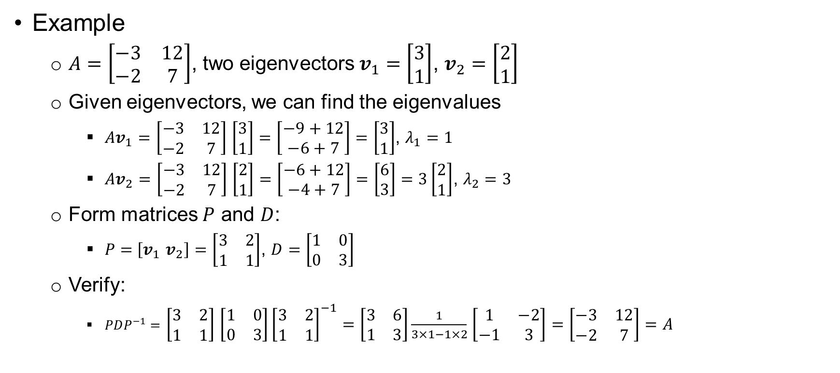

Key points – 8.1.3 Diagonalize a Matrix (2)
Example
$A=\left[\begin{matrix}−3 & 12 \\ −2 & 7\end{matrix}\right]$, two eigenvectors $v_{1}=\left[\begin{matrix}3 \\ 1\end{matrix}\right]$, $v_{2}=\left[\begin{matrix}2 \\ 1\end{matrix}\right]$
Given eigenvectors, we can find the eigenvalues
$Av_{1}=$ $\left[\begin{matrix}−3 & 12 \\ −2 & 7\end{matrix}\right]$ $\left[\begin{matrix}3 \\ 1\end{matrix}\right]=\left[\begin{matrix}−9+12 \\ −6+7\end{matrix}\right]=\left[\begin{matrix}3 \\ 1\end{matrix}\right]$, $λ_{1}=1$
$Av_{2}=$ $\left[\begin{matrix}−3 & 12 \\ −2 & 7\end{matrix}\right]$ $\left[\begin{matrix}2 \\ 1\end{matrix}\right]=\left[\begin{matrix}−6+12 \\ −4+7\end{matrix}\right]=\left[\begin{matrix}6 \\ 3\end{matrix}\right]=3\left[\begin{matrix}2 \\ 1\end{matrix}\right]$, $λ_{2}=3$
Form matrices $P$ and $D$:
$P=$ $\left[v_{1} v_{2}\right]=\left[\begin{matrix}3 & 2 \\ 1 & 1\end{matrix}\right]$, $D=\left[\begin{matrix}1 & 0 \\ 0 & 3\end{matrix}\right]$
Verify:
$PDP^{−1}=$ $\left[\begin{matrix}3 & 2 \\ 1 & 1\end{matrix}\right]$ $\left[\begin{matrix}1 & 0 \\ 0 & 3\end{matrix}\right]{\left[\begin{matrix}3 & 2 \\ 1 & 1\end{matrix}\right]}^{−1}=$ $\left[\begin{matrix}3 & 6 \\ 1 & 3\end{matrix}\right]\frac{1}{3×1−1×2}$ $\left[\begin{matrix}1 & −2 \\ −1 & 3\end{matrix}\right]=\left[\begin{matrix}−3 & 12 \\ −2 & 7\end{matrix}\right]=A$

Slide 16
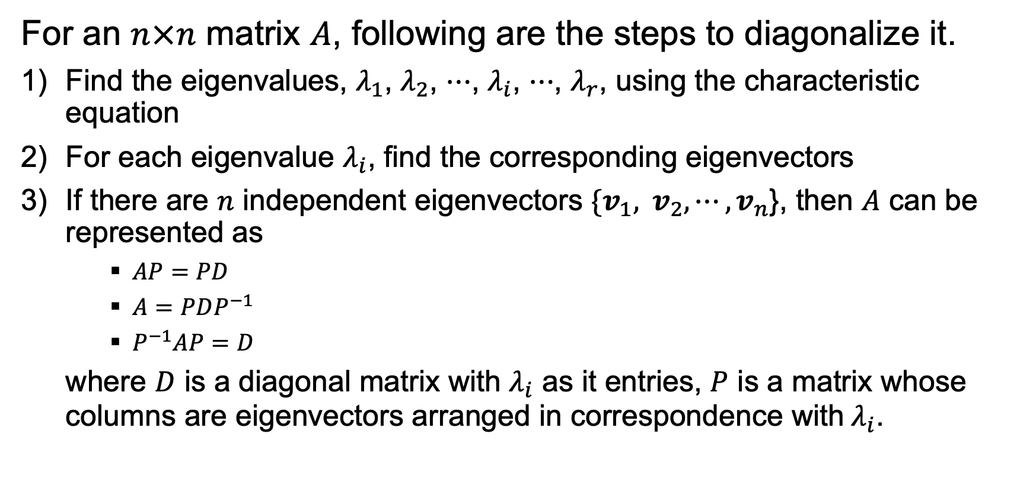

Key points – 8.1.3 Steps to Diagonalize a Matrix
For an $n×n$ matrix $A$, following are the steps to diagonalize it.
Find the eigenvalues, $λ_{1}$, $λ_{2}$, $⋯$, $λ_{i}$, $⋯$, $λ_{r}$, using the characteristic equation
For each eigenvalue $λ_{i}$, find the corresponding eigenvectors
If there are $n$ independent eigenvectors $\{v_{1}, v_{2},⋯,v_{n}$}, then $A$ can be represented as
$AP=PD$
$A=PDP^{−1}$
$P^{−1}AP$ $=D$
where $D$ is a diagonal matrix with $λ_{i}$ as it entries, $P$ is a matrix whose columns are eigenvectors arranged in correspondence with $λ_{i}$.

Slide 17
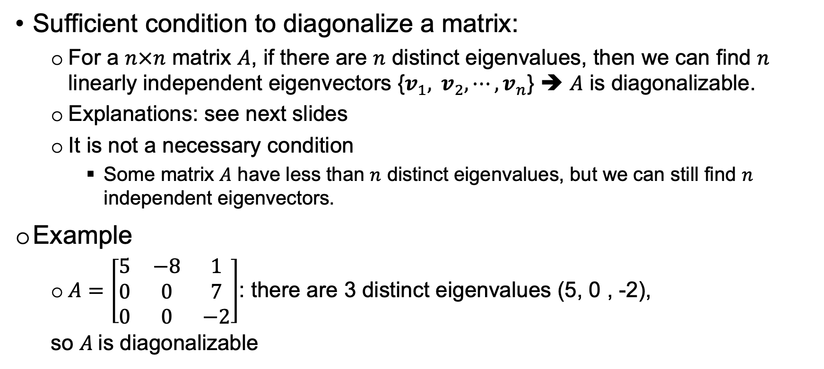
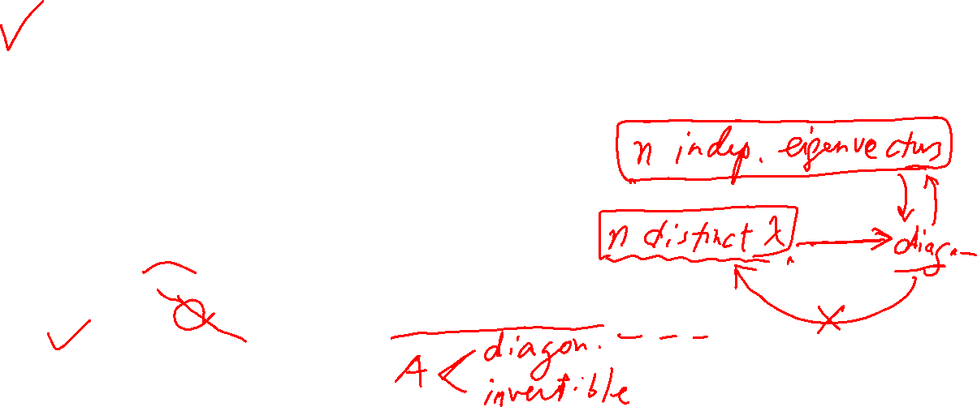
Key points – 8.1.3 When is a Matrix is Diagonalizable?
Sufficient condition to diagonalize a matrix:
For a $n×n$ matrix $A$, if there are $n$ distinct eigenvalues, then we can find $n$ linearly independent eigenvectors {$v_{1}, v_{2},⋯,v_{n}$} ➔ $A$ is diagonalizable.
Explanations: see next slides
It is not a necessary condition
Some matrix $A$ have less than $n$ distinct eigenvalues, but we can still find $n$ independent eigenvectors.
Example
$A=\left[\begin{matrix}5 & −8 & 1 \\ 0 & 0 & 7 \\ 0 & 0 & −2\end{matrix}\right]$: there are 3 distinct eigenvalues (5, 0 , -2),
so $A$is diagonalizable

Slide 18
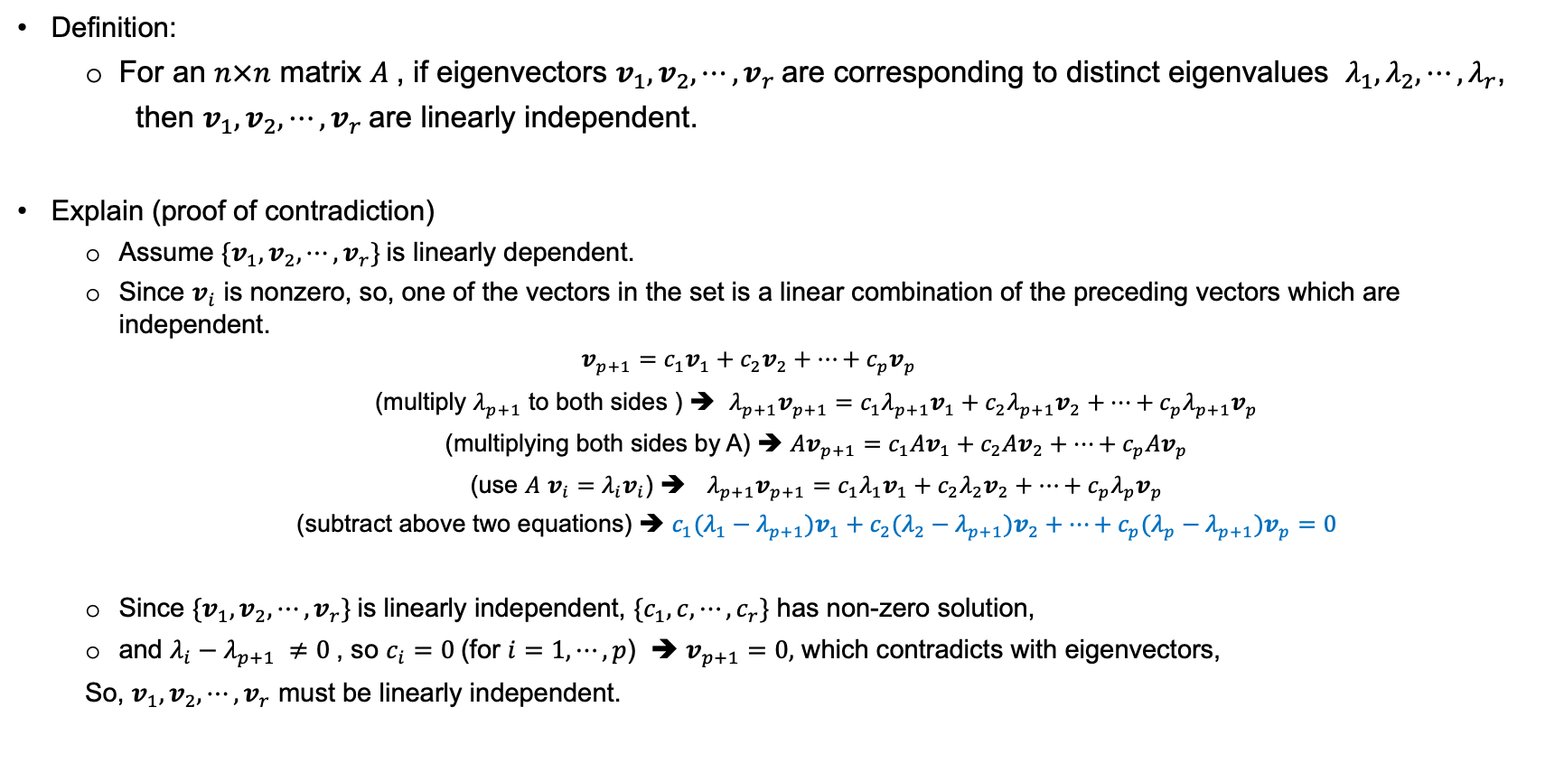
Key points – Independence of Eigenvectors
Revision
Definition:
For an $n×n$ matrix $A$, if eigenvectors $v_{1},v_{2},⋯,v_{r}$are corresponding to distinct eigenvalues $λ_{1},λ_{2},⋯,λ_{r}$,
then $v_{1},v_{2},⋯,v_{r}$are linearly independent.
Explain (proof of contradiction)
Assume ${\{v}_{1},v_{2},⋯,v_{r}\}$is linearly dependent.
Since $v_{i}$ is nonzero, so, one of the vectors in the set is a linear combination of the preceding vectors which are independent.
$$v_{p+1}=c_{1}v_{1}+c_{2}v_{2}+⋯+c_{p}v_{p}$$
(multiply $λ_{p+1}$ to both sides ) ➔ $λ_{p+1}v_{p+1}=c_{1}λ_{p+1}v_{1}+c_{2}λ_{p+1}v_{2}+⋯+c_{p}λ_{p+1}v_{p}$
(multiplying both sides by A) ➔ $Av_{p+1}=c_{1}Av_{1}+c_{2}Av_{2}+⋯+c_{p}Av_{p}$
(use $A$ $v_{i}=λ_{i}v_{i}$) ➔ $λ_{p+1}v_{p+1}=c_{1}λ_{1}v_{1}+c_{2}λ_{2}v_{2}+⋯+c_{p}λ_{p}v_{p}$
(subtract above two equations) ➔ $c_{1}(λ_{1}−λ_{p+1})v_{1}+c_{2}(λ_{2}−λ_{p+1})v_{2}+⋯+c_{p}(λ_{p}−λ_{p+1}{)v}_{p}=0$
Since ${\{v}_{1},v_{2},⋯,v_{r}\}$is linearly independent, ${\{c}_{1},c,⋯,c_{r}\}$ has non-zero solution,
and $λ_{i}−λ_{p+1} ≠0$, so $c_{i}=0$(for $i=1,⋯,p$) ➔ $v_{p+1}=0,$ which contradicts with eigenvectors,
So, $v_{1},v_{2},⋯,v_{r}$ must be linearly independent.

Slide 19
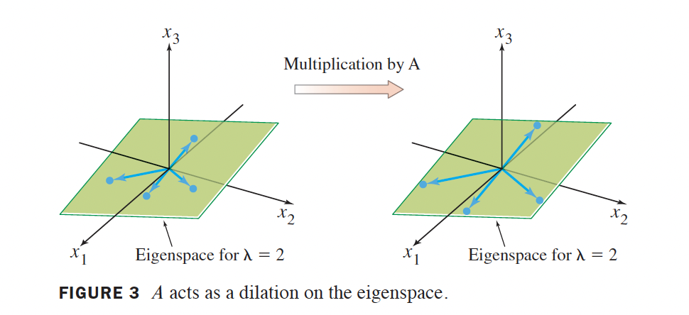
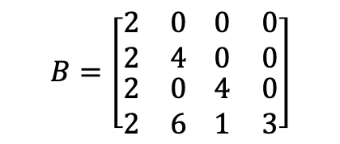
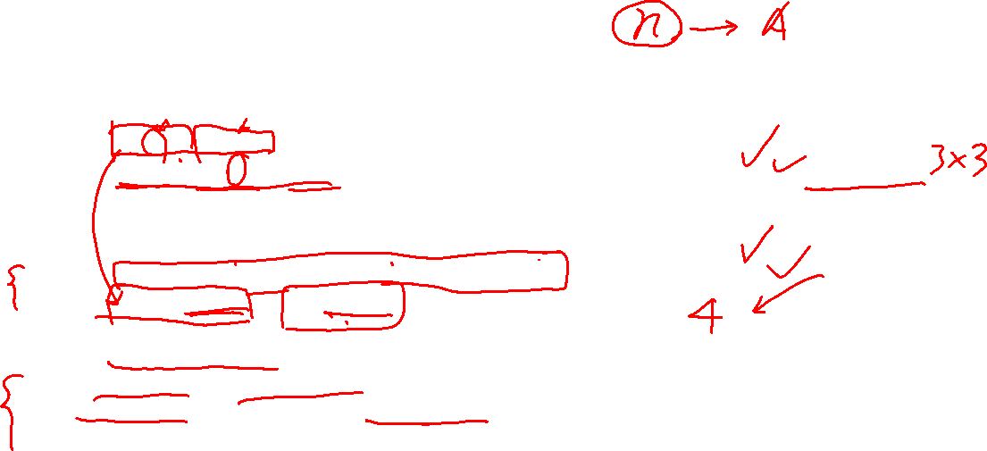
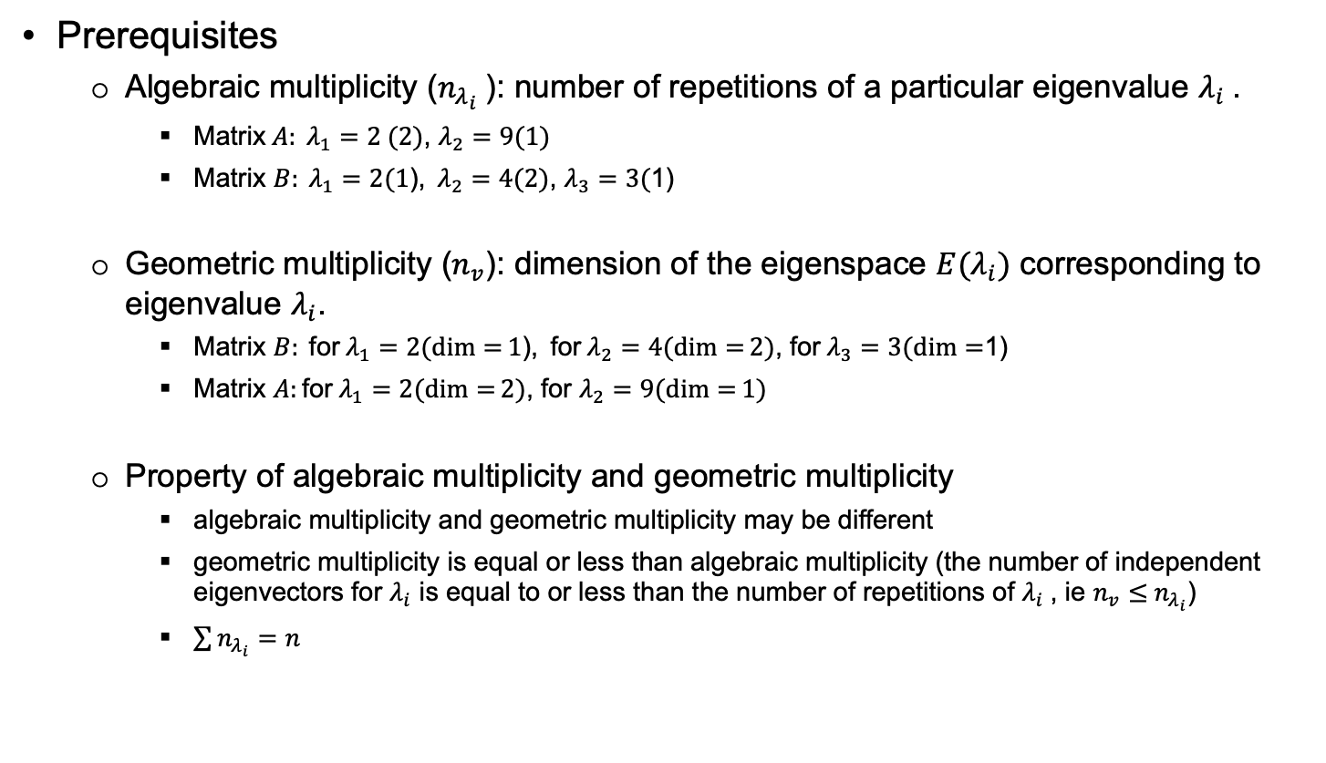
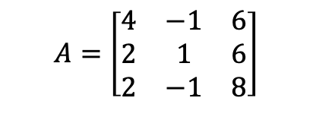
Key points – 8.1.3 Is a Matrix with Repeated Eigenvalues Diagonalizable?
Prerequisites
Algebraic multiplicity ($n_{λ_{i}}$): number of repetitions of a particular eigenvalue $λ_{i}$.
Matrix$A: λ_{1}=2 (2)$, $λ_{2}=9(1)$
Matrix $B: λ_{1}=2(1\text{),} λ_{2}=4(2)$, $λ_{3}=3($1)
Geometric multiplicity ($n_{v}$): dimension of the eigenspace ${E(λ}_{i})$ corresponding to eigenvalue $λ_{i}$.
Matrix $B: {\text{for} λ}_{1}=2(\dim{=}1\text{),} {\text{for} λ}_{2}=4(\dim{=}2)$, ${\text{for} λ}_{3}=3(\dim{=}$1)
Matrix $A:\text{for} λ_{1}=2(\dim{=}2)$, for $λ_{2}=9(\dim{=}1)$
Property of algebraic multiplicity and geometric multiplicity
algebraic multiplicity and geometric multiplicity may be different
geometric multiplicity is equal or less than algebraic multiplicity (the number of independent eigenvectors for $λ_{i}$ is equal to or less than the number of repetitions of $λ_{i}$, ie $n_{v}≤$ $n_{λ_{i}}$)
$\sum{n_{λ_{i}}}=n$
$$A=\left[\begin{matrix}4 & −1 & 6 \\ 2 & 1 & 6 \\ 2 & −1 & 8\end{matrix}\right]$$
$$B=\left[\begin{aligned}\begin{matrix}2 & 0 \\ 2 & 4\end{matrix} \begin{matrix}0 & 0 \\ 0 & 0\end{matrix} \\ \begin{matrix}2 & 0 \\ 2 & 6\end{matrix} \begin{matrix}4 & 0 \\ 1 & 3\end{matrix}\end{aligned}\right]$$
We saw this example before. One of its eigenvalues is 2.

Slide 20
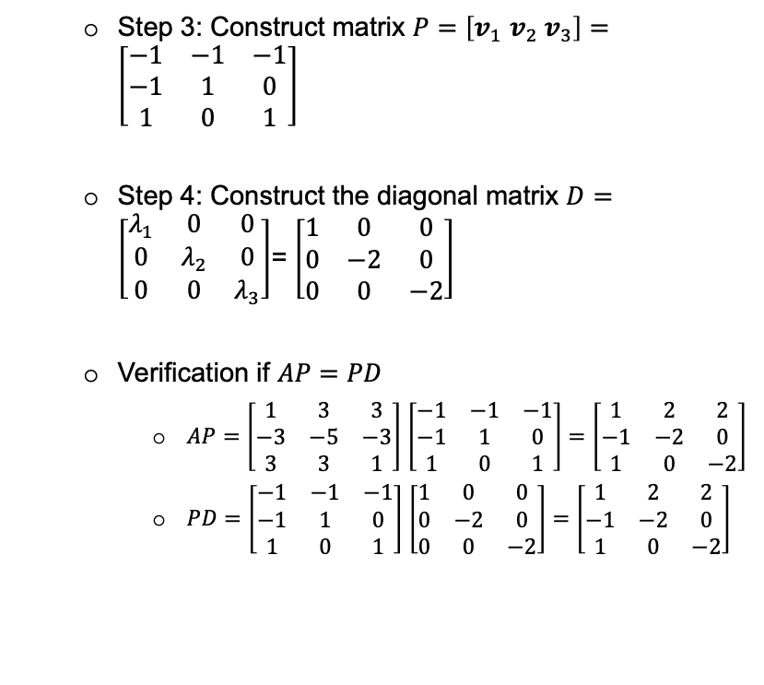
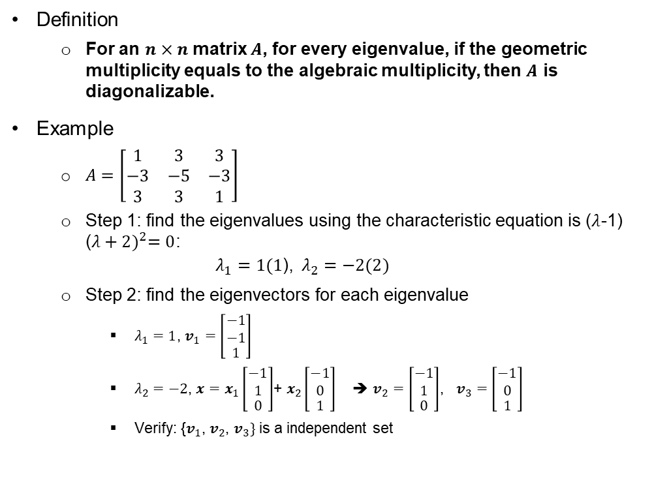

Key points – 8.1.3 Is a Matrix with Repeated Eigenvalues Diagonalizable? (2)
Definition
For an $n×n$ matrix $A$, for every eigenvalue, if the geometric multiplicity equals to the algebraic multiplicity, then $A$ is diagonalizable.
Example
$A=\left[\begin{matrix}1 & 3 & 3 \\ −3 & −5 & −3 \\ 3 & 3 & 1\end{matrix}\right]$
Step 1: find the eigenvalues using the characteristic equation is ($λ$-1) ${\text{(}λ+2)}^{2}=0$:
$$λ_{1}=1(1\text{),} λ_{2}=−2(2)$$
Step 2: find the eigenvectors for each eigenvalue
$λ_{1}=1$, $v_{1}$ $=\left[\begin{matrix}\begin{aligned}−1 \\ −1\end{aligned} \\ 1\end{matrix}\right]$
$λ_{2}=−2$, $x=x_{1}\left[\begin{matrix}\begin{aligned}−1 \\ 1\end{aligned} \\ 0\end{matrix}\right]$+ $x_{2}\left[\begin{matrix}\begin{aligned}−1 \\ 0\end{aligned} \\ 1\end{matrix}\right]$ ➔ $v_{2}=\left[\begin{matrix}\begin{aligned}−1 \\ 1\end{aligned} \\ 0\end{matrix}\right]$, $v_{3}=\left[\begin{matrix}\begin{aligned}−1 \\ 0\end{aligned} \\ 1\end{matrix}\right]$
Verify: {$v_{1}$, $v_{2}$, $v_{3}\}$ is a independent set
Step 3: Construct matrix $P=\left[v_{1} v_{2}{ v}_{3}\right]=\left[\begin{matrix}−1 & −1 & −1 \\ −1 & 1 & 0 \\ 1 & 0 & 1\end{matrix}\right]$
Step 4: Construct the diagonal matrix $D=\left[\begin{matrix}λ_{1} & 0 & 0 \\ 0 & λ_{2} & 0 \\ 0 & 0 & λ_{3}\end{matrix}\right]$= $\left[\begin{matrix}1 & 0 & 0 \\ 0 & −2 & 0 \\ 0 & 0 & −2\end{matrix}\right]$
Verification if $AP=PD$
$AP=$ $\left[\begin{matrix}1 & 3 & 3 \\ −3 & −5 & −3 \\ 3 & 3 & 1\end{matrix}\right]$ $\left[\begin{matrix}−1 & −1 & −1 \\ −1 & 1 & 0 \\ 1 & 0 & 1\end{matrix}\right]=\left[\begin{matrix}1 & 2 & 2 \\ −1 & −2 & 0 \\ 1 & 0 & −2\end{matrix}\right]$
$PD=$ $\left[\begin{matrix}−1 & −1 & −1 \\ −1 & 1 & 0 \\ 1 & 0 & 1\end{matrix}\right]$ $\left[\begin{matrix}1 & 0 & 0 \\ 0 & −2 & 0 \\ 0 & 0 & −2\end{matrix}\right]=$ $\left[\begin{matrix}1 & 2 & 2 \\ −1 & −2 & 0 \\ 1 & 0 & −2\end{matrix}\right]$

Slide 21
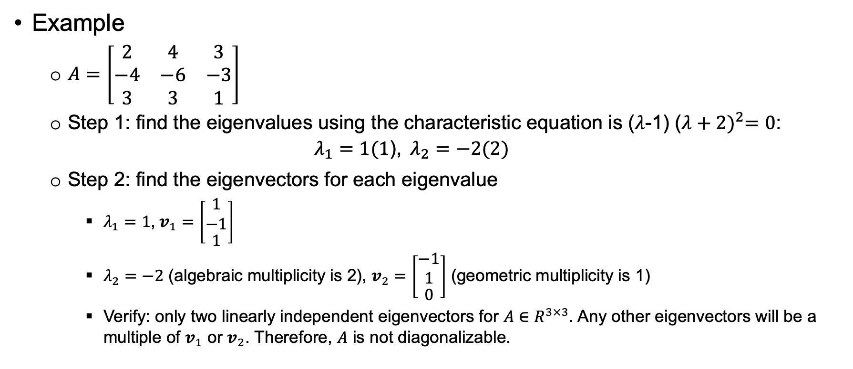

Key points – 8.1.3 Is a Matrix with Repeated Eigenvalues Diagonalizable? (3).
Example
$A=\left[\begin{matrix}2 & 4 & 3 \\ −4 & −6 & −3 \\ 3 & 3 & 1\end{matrix}\right]$
Step 1: find the eigenvalues using the characteristic equation is ($λ$-1) ${\text{(}λ+2)}^{2}=0$:
$$λ_{1}=1(1\text{),} λ_{2}=−2(2)$$
Step 2: find the eigenvectors for each eigenvalue
$λ_{1}=1$, $v_{1}$ $=\left[\begin{matrix}\begin{aligned}1 \\ −1\end{aligned} \\ 1\end{matrix}\right]$
$λ_{2}=−2$ (algebraic multiplicity is 2), $v_{2}=\left[\begin{matrix}\begin{aligned}−1 \\ 1\end{aligned} \\ 0\end{matrix}\right]$ (geometric multiplicity is 1)
Verify: only two linearly independent eigenvectors for $A∈R^{3×3}$. Any other eigenvectors will be a multiple of $v_{1}$ or $v_{2}$. Therefore, $A$ is not diagonalizable.

Slide 22
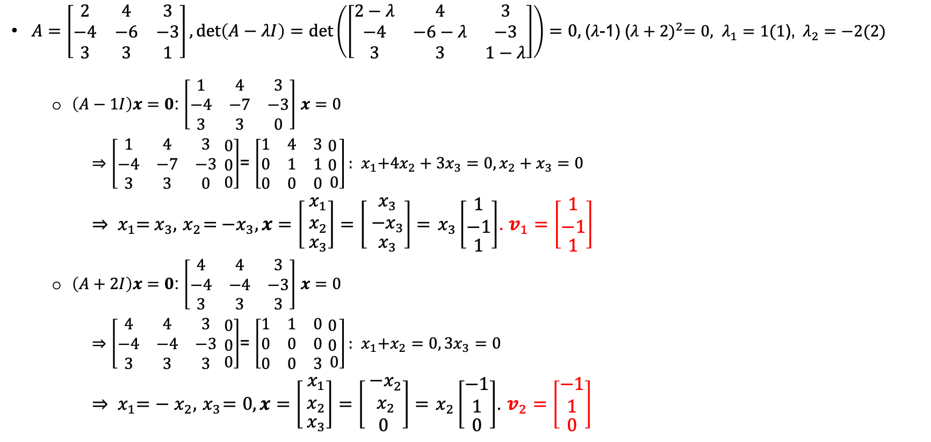
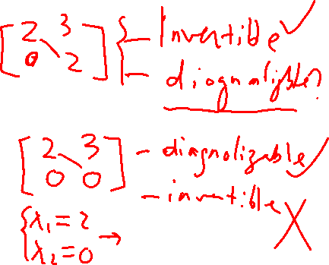

Continued to the previous example:
$A=\left[\begin{matrix}2 & 4 & 3 \\ −4 & −6 & −3 \\ 3 & 3 & 1\end{matrix}\right], det\left(A−λI\right)=det\left(\left[\begin{matrix}2−λ & 4 & 3 \\ −4 & −6−λ & −3 \\ 3 & 3 & 1−λ\end{matrix}\right]\right)=0,$($λ$-1) ${\text{(}λ+2)}^{2}=0, λ_{1}=1(1\text{),} λ_{2}=−2(2)$
$\left(A−1I\right)x=0$: $\left[\begin{matrix}1 & 4 & 3 \\ −4 & −7 & −3 \\ 3 & 3 & 0\end{matrix}\right]$ $x=0$
$⇒$ $\left[\begin{matrix}1 & 4 & 3 \\ −4 & −7 & −3 \\ 3 & 3 & 0\end{matrix}\begin{matrix}\begin{aligned} 0 \\ 0\end{aligned} \\ 0\end{matrix}\right]$= $\left[\begin{matrix}1 & 4 & 3 \\ 0 & 1 & 1 \\ 0 & 0 & 0\end{matrix}\begin{matrix}\begin{aligned} 0 \\ 0\end{aligned} \\ 0\end{matrix}\right]:$ ${ x}_{1}+{4x}_{2}+{3x}_{3}=0,x_{2}+x_{3}=0$
$⇒$ ${ x}_{1}={ x}_{3},{ x}_{2}={ −x}_{3}, x=\left[\begin{matrix}\begin{aligned}{ x}_{1} \\ { x}_{2}\end{aligned} \\ { x}_{3}\end{matrix}\right]=\left[\begin{matrix}\begin{aligned}{ x}_{3} \\ { −x}_{3}\end{aligned} \\ { x}_{3}\end{matrix}\right]$ $={ x}_{3}\left[\begin{matrix}\begin{aligned}1 \\ −1\end{aligned} \\ 1\end{matrix}\right]$. $v_{1}$ $=\left[\begin{matrix}\begin{aligned}1 \\ −1\end{aligned} \\ 1\end{matrix}\right]$
$\left(A+2I\right)x=0$: $\left[\begin{matrix}4 & 4 & 3 \\ −4 & −4 & −3 \\ 3 & 3 & 3\end{matrix}\right]$ $x=0$
$⇒$ $\left[\begin{matrix}4 & 4 & 3 \\ −4 & −4 & −3 \\ 3 & 3 & 3\end{matrix}\begin{matrix}\begin{aligned} 0 \\ 0\end{aligned} \\ 0\end{matrix}\right]$= $\left[\begin{matrix}1 & 1 & 0 \\ 0 & 0 & 0 \\ 0 & 0 & 3\end{matrix}\begin{matrix}\begin{aligned} 0 \\ 0\end{aligned} \\ 0\end{matrix}\right]:$ ${ x}_{1}+x_{2}=0, 3x_{3}=0$
$⇒$ ${ x}_{1}=−{ x}_{2},{ x}_{3}=0, x=\left[\begin{matrix}\begin{aligned}{ x}_{1} \\ { x}_{2}\end{aligned} \\ { x}_{3}\end{matrix}\right]=\left[\begin{matrix}\begin{aligned}{ −x}_{2} \\ { x}_{2}\end{aligned} \\ 0\end{matrix}\right]$ $={ x}_{2}\left[\begin{matrix}\begin{aligned}−1 \\ 1\end{aligned} \\ 0\end{matrix}\right]$. $v_{2}=\left[\begin{matrix}\begin{aligned}−1 \\ 1\end{aligned} \\ 0\end{matrix}\right]$

Slide 23
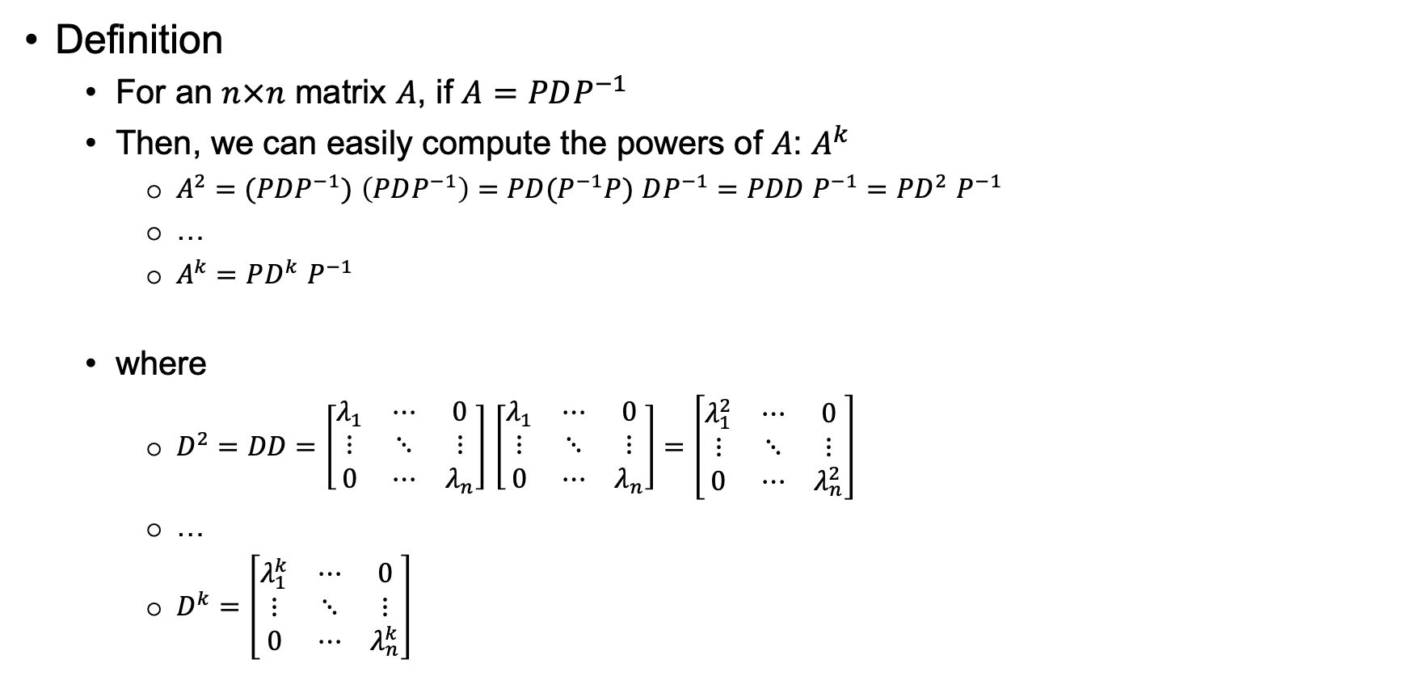

Key points – 8.1.4 Compute the Powers of A
Definition
For an $n×n$ matrix $A$, if $A=PDP^{−1}$
Then, we can easily compute the powers of $A$: $A^{k}$
$A^{2}=(PDP^{−1})$ $\left(PDP^{−1}\right)=$ $PD(P^{−1}P)$ $DP^{−1}=PDD P^{−1}=PD^{2}$ $P^{−1}$
…
$A^{k}=$ $PD^{k}$ $P^{−1}$
where
$D^{2}=DD=\left[\begin{matrix}λ_{1} & ⋯ & 0 \\ ⋮ & ⋱ & ⋮ \\ 0 & ⋯ & λ_{n}\end{matrix}\right]$ $\left[\begin{matrix}λ_{1} & ⋯ & 0 \\ ⋮ & ⋱ & ⋮ \\ 0 & ⋯ & λ_{n}\end{matrix}\right]=\left[\begin{matrix}λ_{1}^{2} & ⋯ & 0 \\ ⋮ & ⋱ & ⋮ \\ 0 & ⋯ & λ_{n}^{2}\end{matrix}\right]$
…
$D^{k}=\left[\begin{matrix}λ_{1}^{k} & ⋯ & 0 \\ ⋮ & ⋱ & ⋮ \\ 0 & ⋯ & λ_{n}^{k}\end{matrix}\right]$

Slide 24
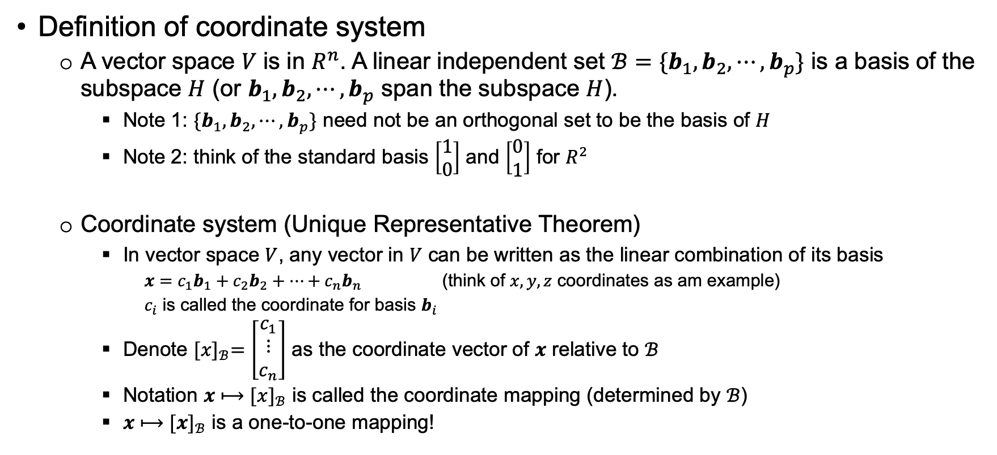
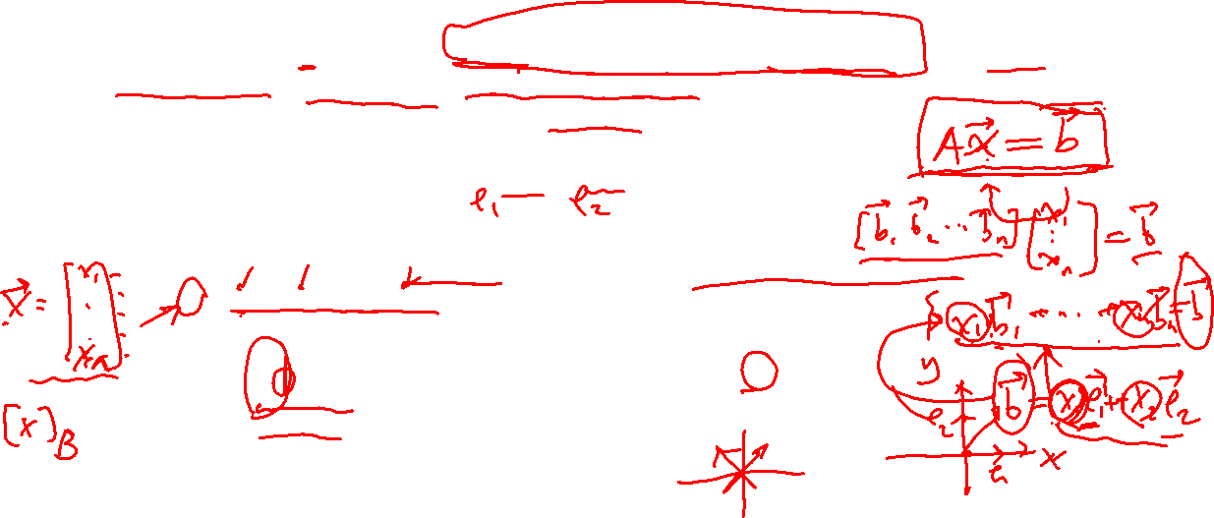
Key points – 8.1.5A Coordinate System
Definition of coordinate system
A vector space $V \text{is} \text{in} R^{n}$. A linear independent set $ℬ=\{b_{1},b_{2},⋯,b_{p}\}$ is a basis of the subspace $H$ (or $b_{1},b_{2},⋯,b_{p}$ span the subspace $H$).
Note 1: ${\{b}_{1},b_{2},⋯,b_{p}\}$ need not be an orthogonal set to be the basis of $H$
Note 2: think of the standard basis $\left[\begin{matrix}1 \\ 0\end{matrix}\right]$ and $\left[\begin{matrix}0 \\ 1\end{matrix}\right]$ for $R^{2}$
Coordinate system (Unique Representative Theorem)
In vector space $V$, any vector in $V$ can be written as the linear combination of its basis
$x=c_{1}b_{1}+c_{2}b_{2}+⋯+c_{n}b_{n}$ (think of $x,y,z$ coordinates as am example)
$c_{i}$ is called the coordinate for basis $b_{i}$
Denote ${[x]}_{ℬ}=\left[\begin{matrix}c_{1} \\ ⋮ \\ c_{n}\end{matrix}\right]$ as the coordinate vector of $x$ relative to $ℬ$
Notation $x⟼$ ${[x]}_{ℬ}$ is called the coordinate mapping (determined by $ℬ$)
$x⟼$ ${[x]}_{ℬ}$ is a one-to-one mapping!

Slide 25
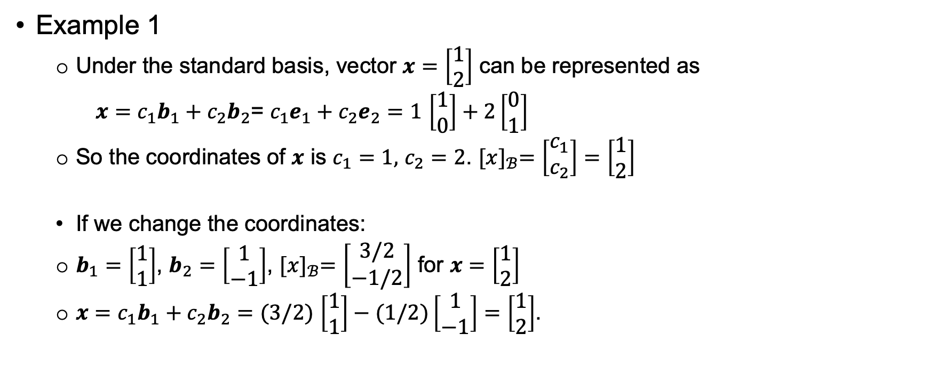
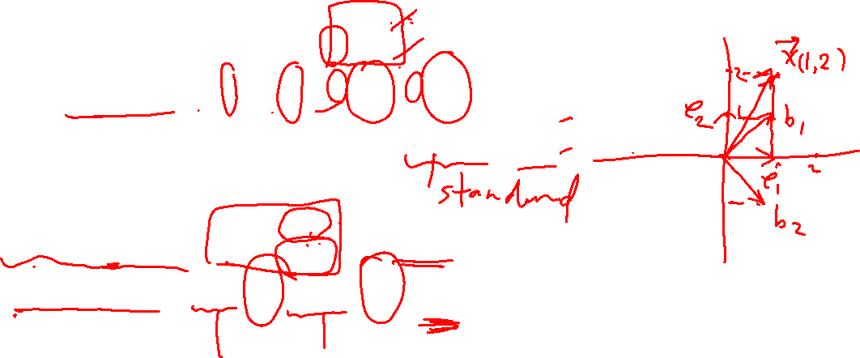
Key points – 8.1.5A Coordinate System (2)
Example 1
Under the standard basis, vector $x=\left[\begin{matrix}1 \\ 2\end{matrix}\right]$ can be represented as
$x=c_{1}b_{1}+c_{2}b_{2}$= $c_{1}e_{1}+c_{2}e_{2}=1$ $\left[\begin{matrix}1 \\ 0\end{matrix}\right]+2\left[\begin{matrix}0 \\ 1\end{matrix}\right]$
So the coordinates of $x$ is $c_{1}=1,$ $c_{2}=2$. ${[x]}_{ℬ}=\left[\begin{matrix}c_{1} \\ c_{2}\end{matrix}\right]=\left[\begin{matrix}1 \\ 2\end{matrix}\right]$
If we change the coordinates:
$b_{1}=\left[\begin{matrix}1 \\ 1\end{matrix}\right]$, $b_{2}=\left[\begin{matrix}1 \\ −1\end{matrix}\right]$, ${[x]}_{ℬ}=\left[\begin{matrix}3/2 \\ −1/2\end{matrix}\right]$ for $x=\left[\begin{matrix}1 \\ 2\end{matrix}\right]$
$x=c_{1}b_{1}+c_{2}b_{2}=$ $(3/2)$ $\left[\begin{matrix}1 \\ 1\end{matrix}\right]−(1/2)\left[\begin{matrix}1 \\ −1\end{matrix}\right]=$ $\left[\begin{matrix}1 \\ 2\end{matrix}\right]$.

Slide 26
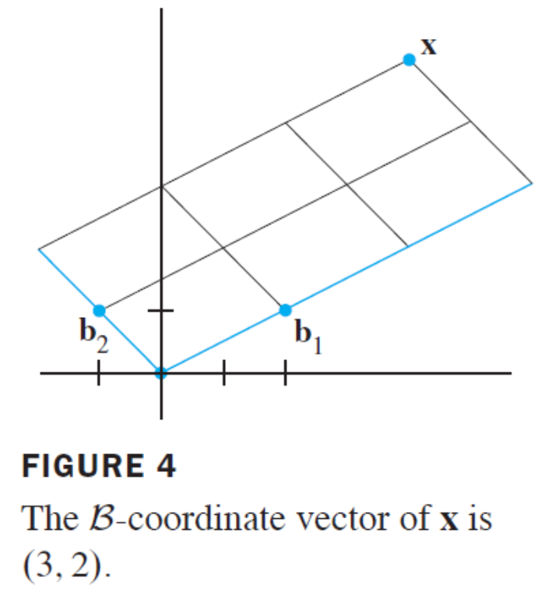
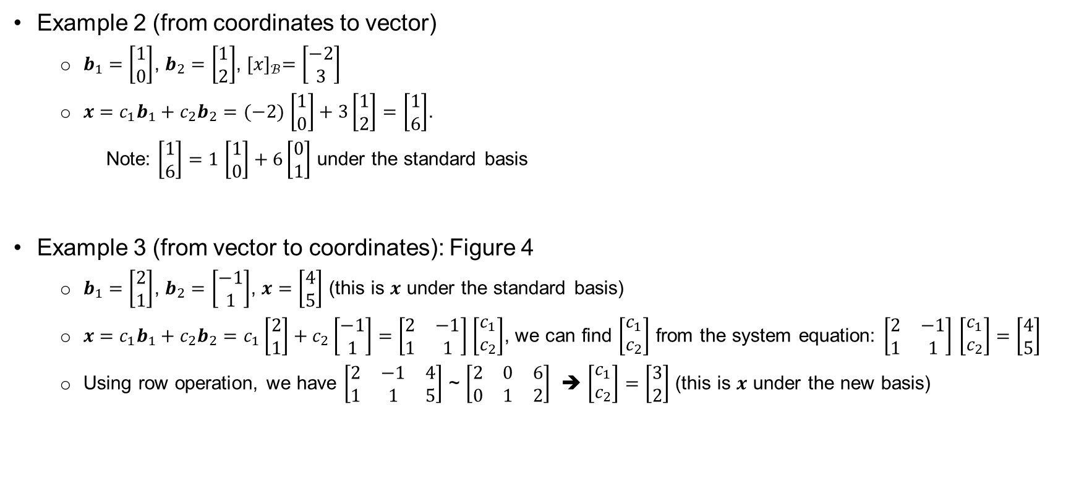
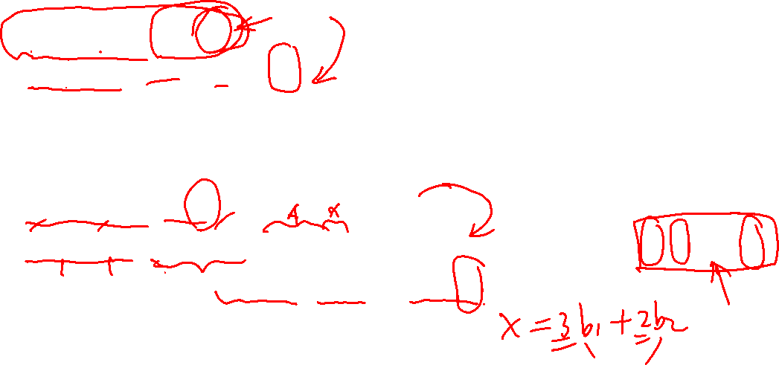
Key points – 8.1.5A Coordinate System (3)
Example 2 (from coordinates to vector)
$b_{1}=\left[\begin{matrix}1 \\ 0\end{matrix}\right]$, $b_{2}=\left[\begin{matrix}1 \\ 2\end{matrix}\right]$, ${[x]}_{ℬ}=\left[\begin{matrix}−2 \\ 3\end{matrix}\right]$
$x=c_{1}b_{1}+c_{2}b_{2}=$ $(−2)$ $\left[\begin{matrix}1 \\ 0\end{matrix}\right]+3\left[\begin{matrix}1 \\ 2\end{matrix}\right]=$ $\left[\begin{matrix}1 \\ 6\end{matrix}\right]$.
Note: $\left[\begin{matrix}1 \\ 6\end{matrix}\right]=1$ $\left[\begin{matrix}1 \\ 0\end{matrix}\right]+6\left[\begin{matrix}0 \\ 1\end{matrix}\right]$ under the standard basis
Example 3 (from vector to coordinates): Figure 4
$b_{1}=\left[\begin{matrix}2 \\ 1\end{matrix}\right]$, $b_{2}=\left[\begin{matrix}−1 \\ 1\end{matrix}\right]$, $x=\left[\begin{matrix}4 \\ 5\end{matrix}\right]$ (this is $x$ under the standard basis)
$x=c_{1}b_{1}+c_{2}b_{2}=$ $c_{1}\left[\begin{matrix}2 \\ 1\end{matrix}\right]+c_{2}\left[\begin{matrix}−1 \\ 1\end{matrix}\right]=\left[\begin{matrix}2 & −1 \\ 1 & 1\end{matrix}\right]$ $\left[\begin{matrix}c_{1} \\ c_{2}\end{matrix}\right]$, we can find $\left[\begin{matrix}c_{1} \\ c_{2}\end{matrix}\right]$ from the system equation: $\left[\begin{matrix}2 & −1 \\ 1 & 1\end{matrix}\right]$ $\left[\begin{matrix}c_{1} \\ c_{2}\end{matrix}\right]=$ $\left[\begin{matrix}4 \\ 5\end{matrix}\right]$
Using row operation, we have $\left[\begin{matrix}2 & −1 & 4 \\ 1 & 1 & 5\end{matrix}\right]$ ~ $\left[\begin{matrix}2 & 0 & 6 \\ 0 & 1 & 2\end{matrix}\right]$ ➔ $\left[\begin{matrix}c_{1} \\ c_{2}\end{matrix}\right]=\left[\begin{matrix}3 \\ 2\end{matrix}\right]$ (this is $x$ under the new basis)

Slide 27
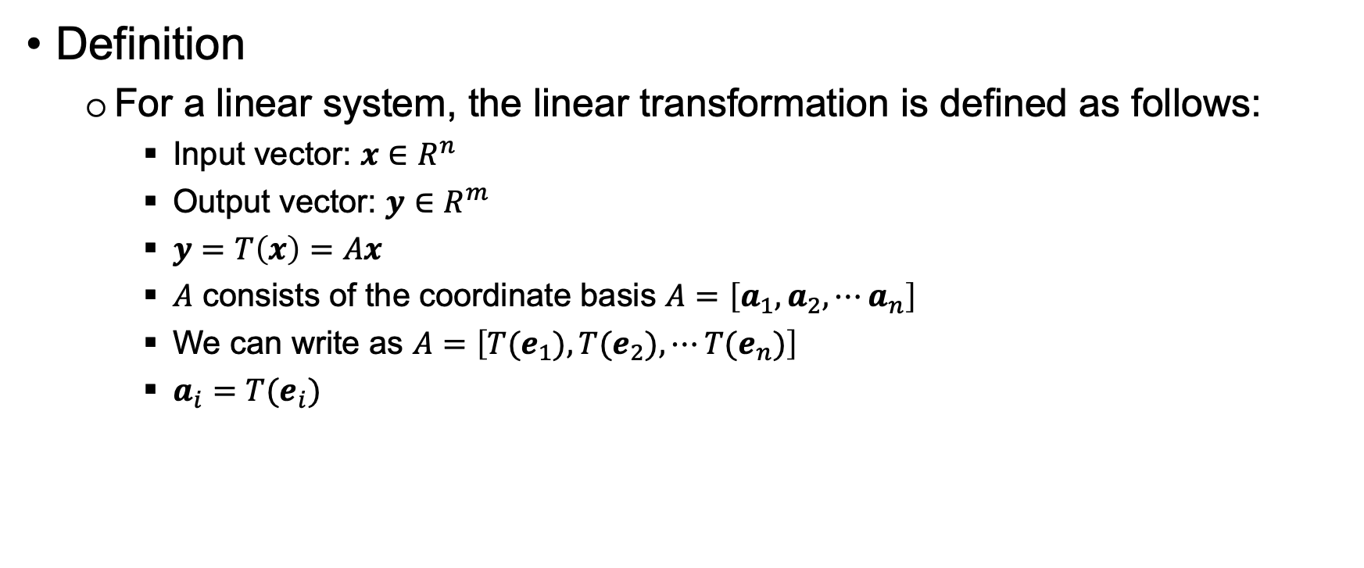

Key points – 8.1.5B Change of Basis
Definition
For a linear system, the linear transformation is defined as follows:
Input vector: $x∈R^{n}$
Output vector: $y∈R^{m}$
$y=T\left(x\right)=Ax$
$A$ consists of the coordinate basis $A=\left[a_{1},a_{2},⋯a_{n}\right]$
We can write as $A=\left[{T(e}_{1}),{T(e}_{2}),⋯{T(e}_{n})\right]$
$a_{i}={T(e}_{i})$

Slide 28
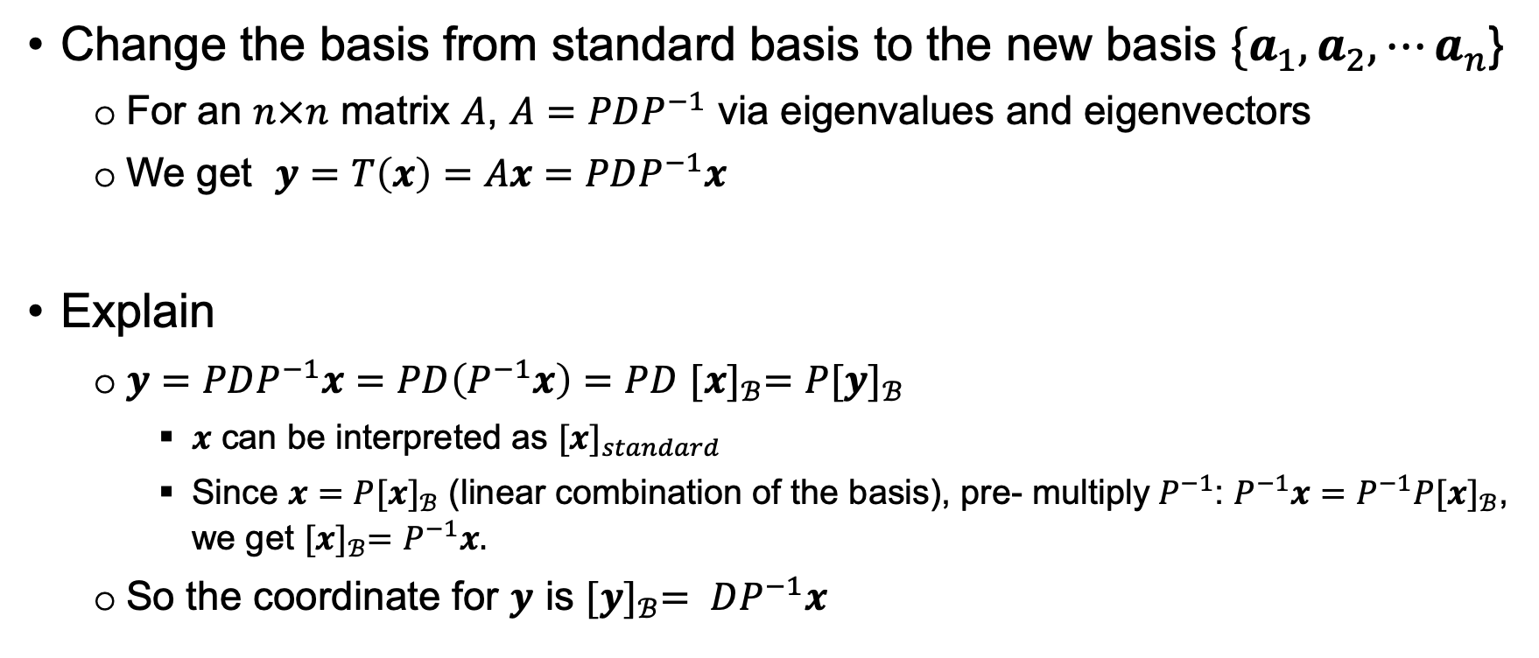
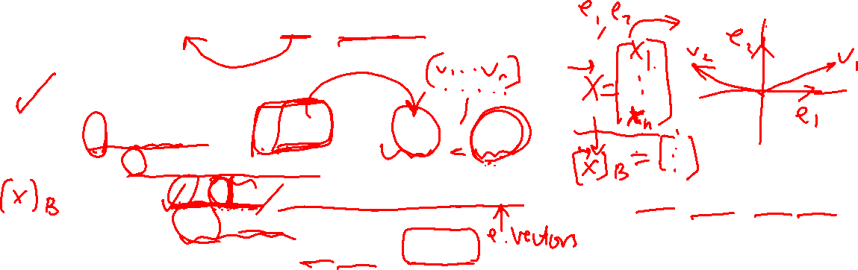
Key points – 8.1.5B Change of Basis (2)
Change the basis from standard basis to the new basis ${\{a}_{1},a_{2},⋯a_{n}$}
For an $n×n$ matrix $A$, $A=PDP^{−1}$ via eigenvalues and eigenvectors
We get $y=T\left(x\right)=Ax=$ $PDP^{−1}x$
Explain
$y=PDP^{−1}x=PD\left(P^{−1}x\right)=$ $PD$ ${[x]}_{ℬ}=$ $P{[y]}_{ℬ}$
$x$ can be interpreted as ${[x]}_{standard}$
Since ${x=P[x]}_{ℬ}$ (linear combination of the basis), pre- multiply $P^{−1}$: ${P^{−1}x=P^{−1}P[x]}_{ℬ}$, we get ${[x]}_{ℬ}=P^{−1}x.$
So the coordinate for $y$ is ${[y]}_{ℬ}= DP^{−1}x$

Slide 29
End

